Slide 1
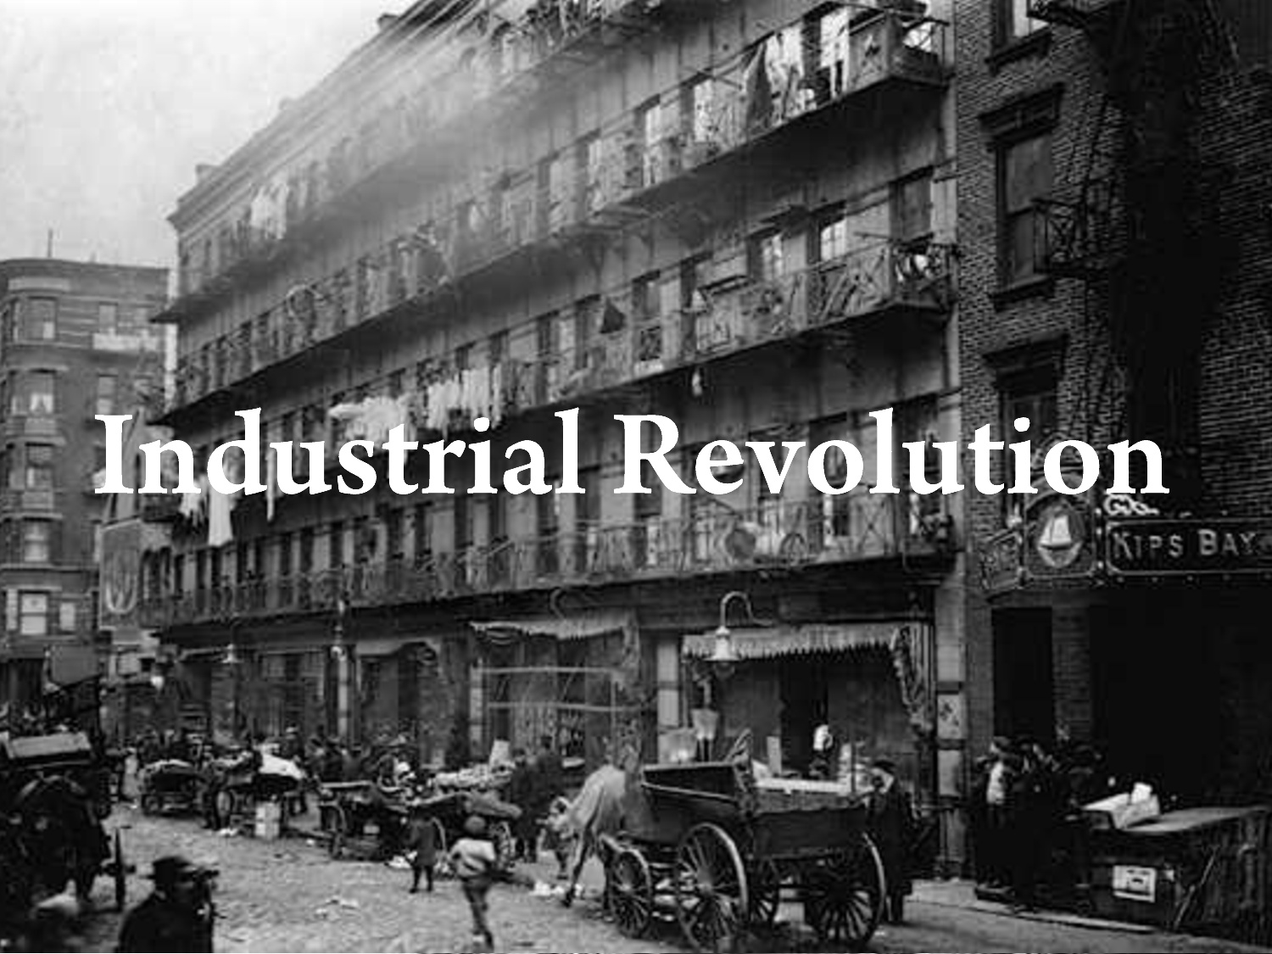

Slide 2
Presentation Instructions
At the top of each slide is a question. Write the question in your Social Studies Notebook, THEN answer the question. For some questions you will need to use inference or prediction to answer, others the information posted on the slide.

Slide 3
What would you expect to learn about from the video?
Flocabulary—Fill in the Lyrics.
video

Slide 4
How did the Industrial Revolution influence people's life?
Life Before 1750
People live in rural villages and worked with their hands.
People grew their own food.
People traveled by foot, horse, or sail.
Life After 1850
People live and work in industrial cities.
Most buy food and clothing made in factories.
They can travel by train or steamboat.

Slide 5
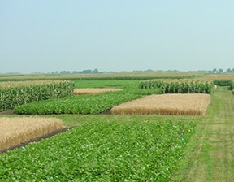
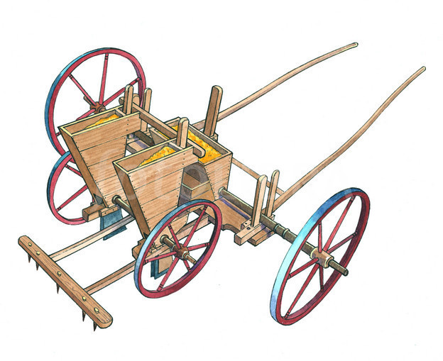
Why did the Industrial Revolution start?
Agricultural Changes
  Wealthy landowners buy land from small farmers and enclose large farms
  This allowed wealthy farmers to try new farming methods to produce more crops
    Crop Rotation-The practice of rotating use of different fields from crop to crop each year, to avoid exhausting the soil.
New Inventions: Jethro Tull invents the Seed Drill that allows farmers to plant seeds at a specific depth.

Slide 6
What is the result of the
Agricultural Revolution?
As food supplies and living conditions improve, population increases.
An increase in population creates a demand for food and goods.
Small farmers are forced from their land to cities to work in factories. (Push Factor)
This agricultural revolution contributed to a population explosion in Europe
1700
1800
Britain
5,000,000
9,000,000
Europe
120,000,000
180,000,000

Slide 7

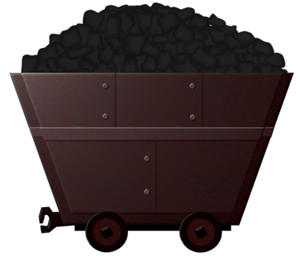

Why did the Industrial Revolution begin in England?
Large population and extensive natural resources
Water power and coal to fuel new machines
Iron ore to construct machines, tools, and buildings
Rivers for transportation
Harbors for merchant ships to set sail

Slide 8
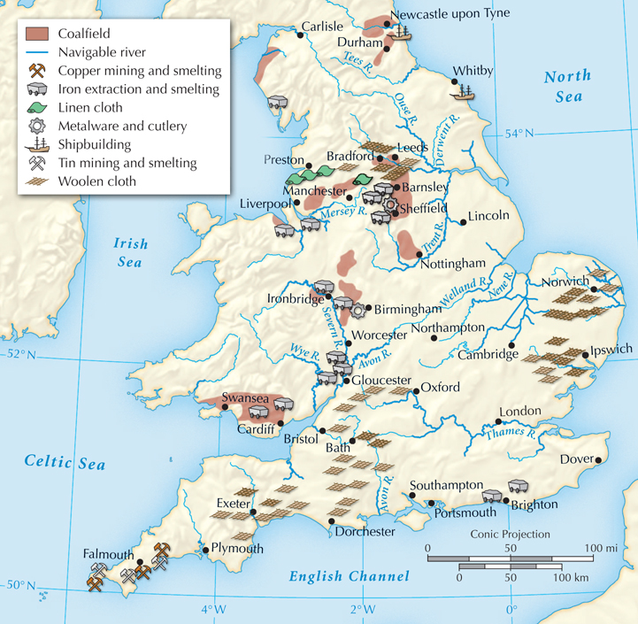
Where do cities develop in England?
Near water ways and areas that had rich natural resources.

Slide 9
In the 1700s, Britain had skilled inventors,
a ready workforce, and a growing population.
To meet the growing demand for jobs and products, one more thing was needed:
capital, or money to start new businesses.

Slide 10
Entrepreneurs needed capital to invest in business enterprises such as shipping, mining, and manufacturing.
With a healthy economy, many were now willing to risk their money on new ventures.
From the mid-1600s, England had prospered from trade.
A business class had accumulated
the needed capital.

Slide 11
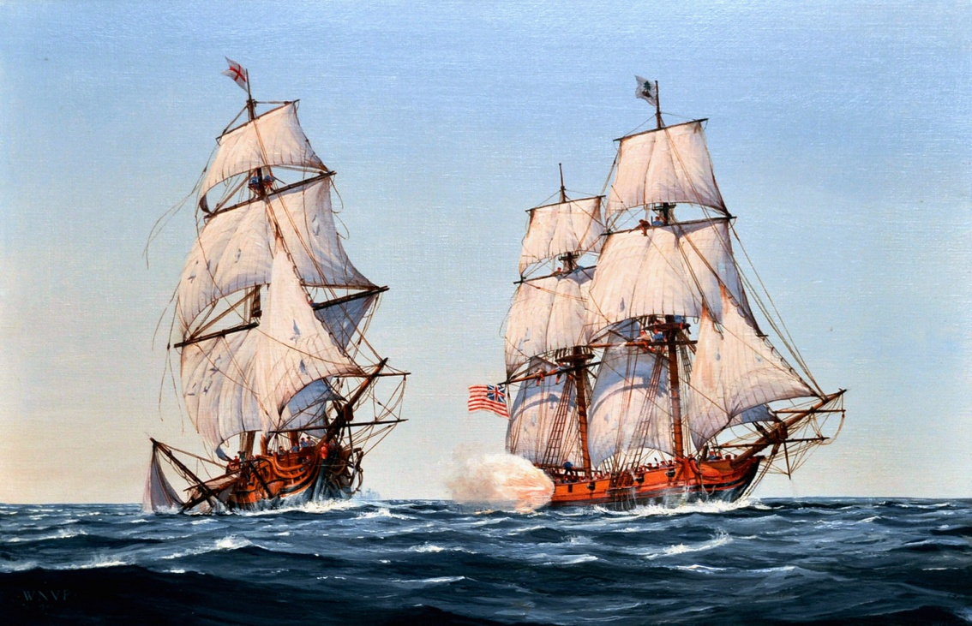
Britain had additional advantages.
Britain had a stable government that supported economic growth.
Other countries had river tolls, but Britain had no such barriers.
The powerful British navy protected shipping and overseas trade.

Slide 12
How did the Industrial Revolution change people's way of life?
Positive effects:
  People could afford to heat their homes
  People ate better and wore better clothes
  Cities grow and England became a very wealthy country

Slide 13
Workers "Pulled" to Cities
Factories located in cities brought waves of new workers
Urbanization or the building of cities and movement of people to cities

Slide 14
What were some negative effects of Industrialization?
Cities had poor living conditions
There were no sanitary codes, no building codes, people lacked education and police protection.
Unpaved streets had no drains and collected heaps of garbage
Workers lived in dark, dirty shelters, and families lived in one room slums.
Sickness was wide spread
Average life span for a person living in the city was 17 years old

Slide 15
Working Conditions
Average worker worked:
  14 hours a day, 6 days a week
  Factories will not well lit or clean.
  Machines injured workers
  Coal Mines were dangerous as miner’s breathed in coal dust

Slide 16
Why was the Industrial Revolution a turning point in history?
Video

